Slide 1
Leadership Expectations
By CC Brubaker

Slide 2
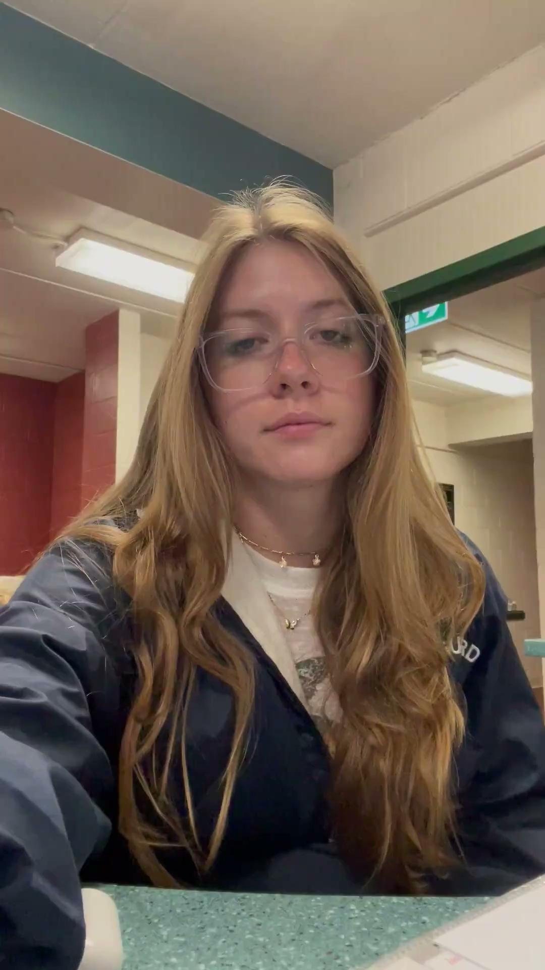
Inappropriate Conversation
Oftentimes we hear people talking about drinking on the weekend or speeding through neighborhood streets.

Slide 3
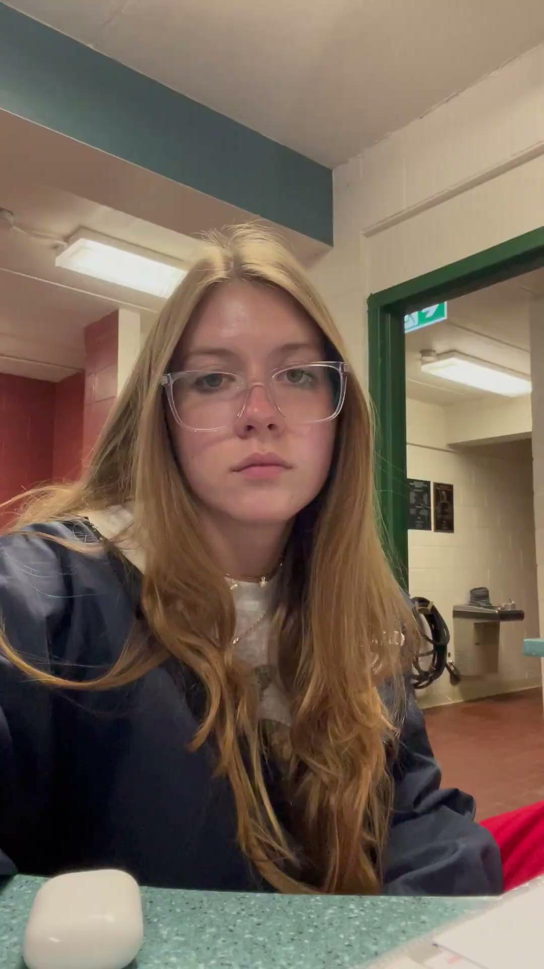
Appropriate Conversation
It is important to try to redirect the conversation to something more work appropriate.

Slide 4
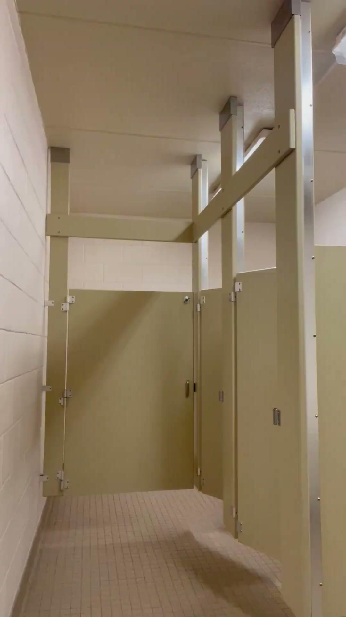
Ignoring Something that Needs to be Cleaned
Sometimes we see a mess on deck during our breaks and want to ignore it so that we can enjoy our break.

Slide 5
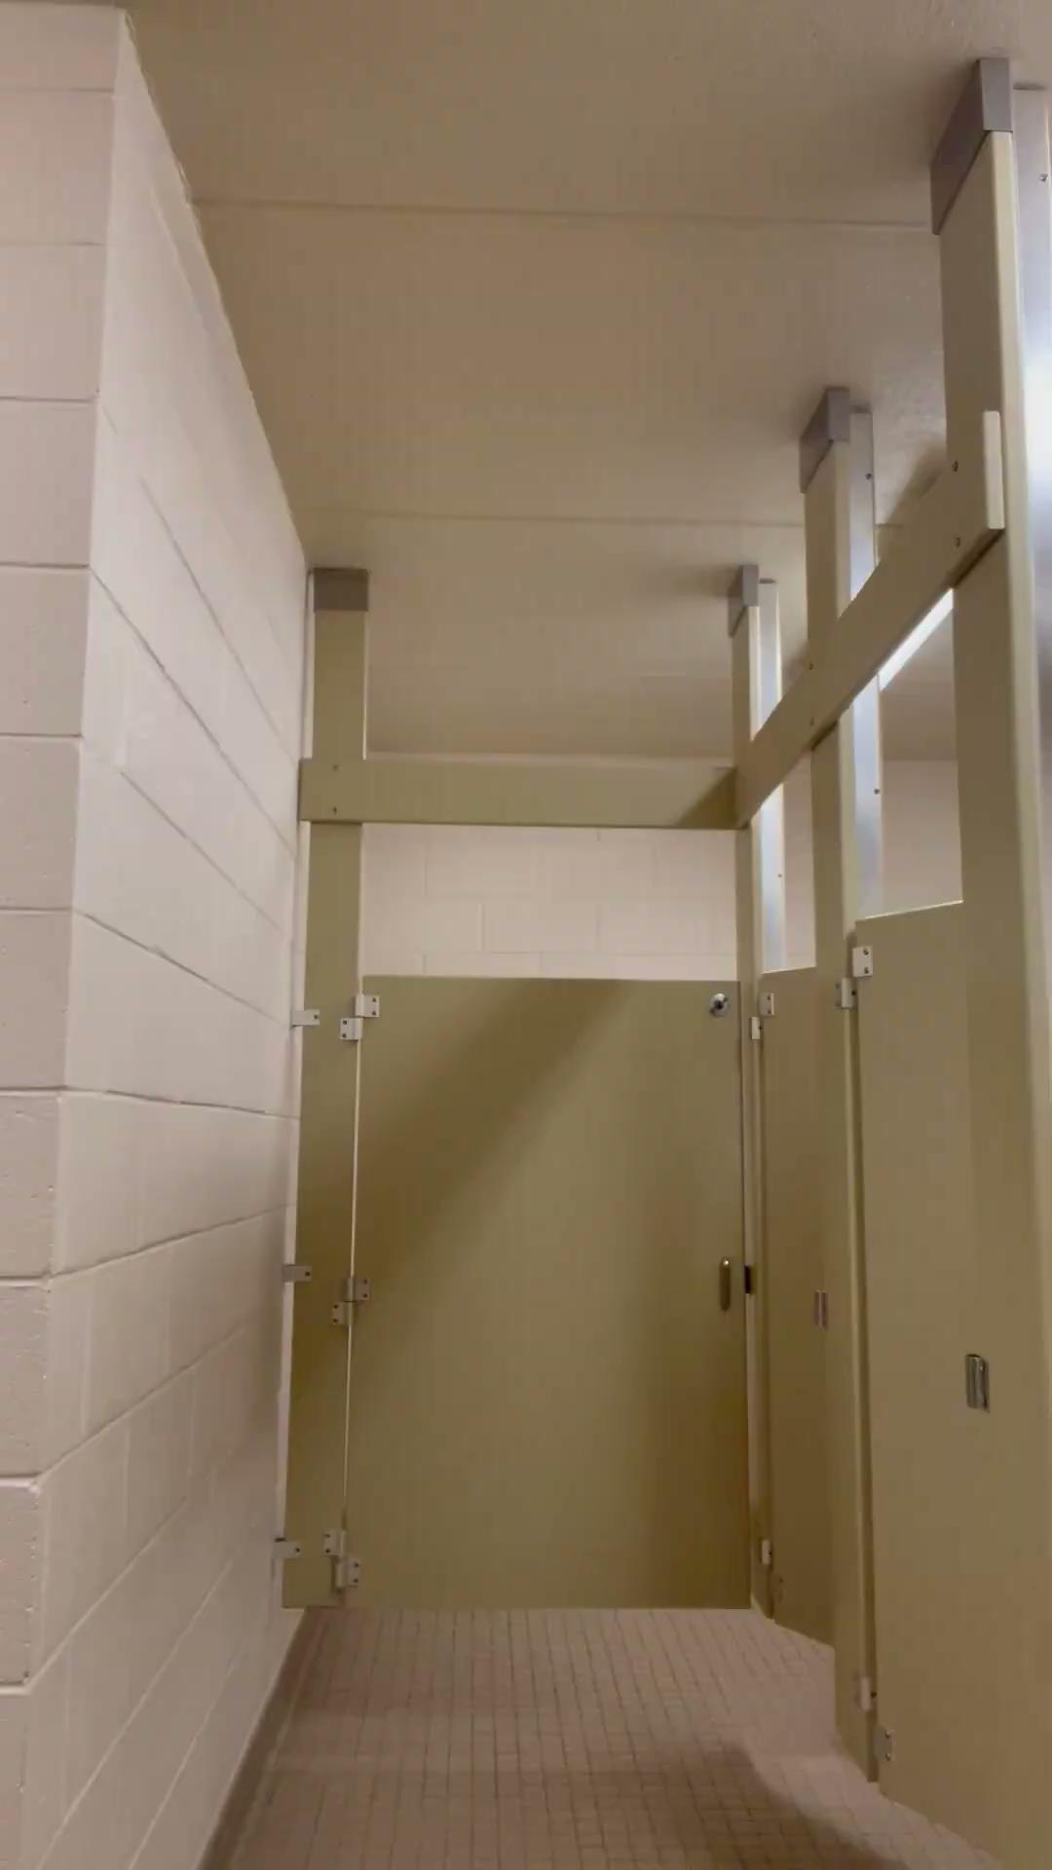
Cleaning a Mess
When we see a mess on deck, we should take initiative to clean it, even if we are not told to do it. It is important to keep our pool clean and professional.

Slide 6
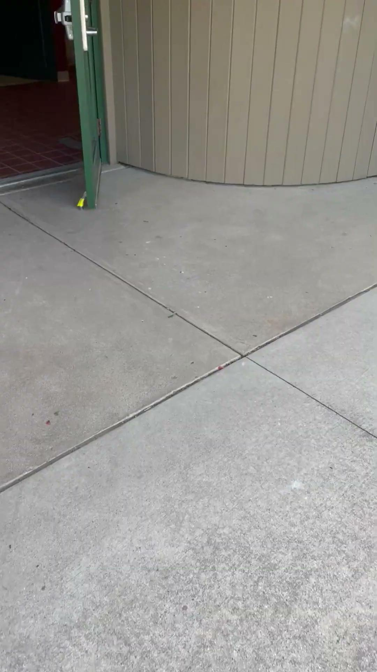
Showing Up On Time or Late to a Shift
Showing up late for a shift not only makes you look unprofessional, and creates a less than ideal situation, but it sets a bad precedent for lifeguards.

Slide 7
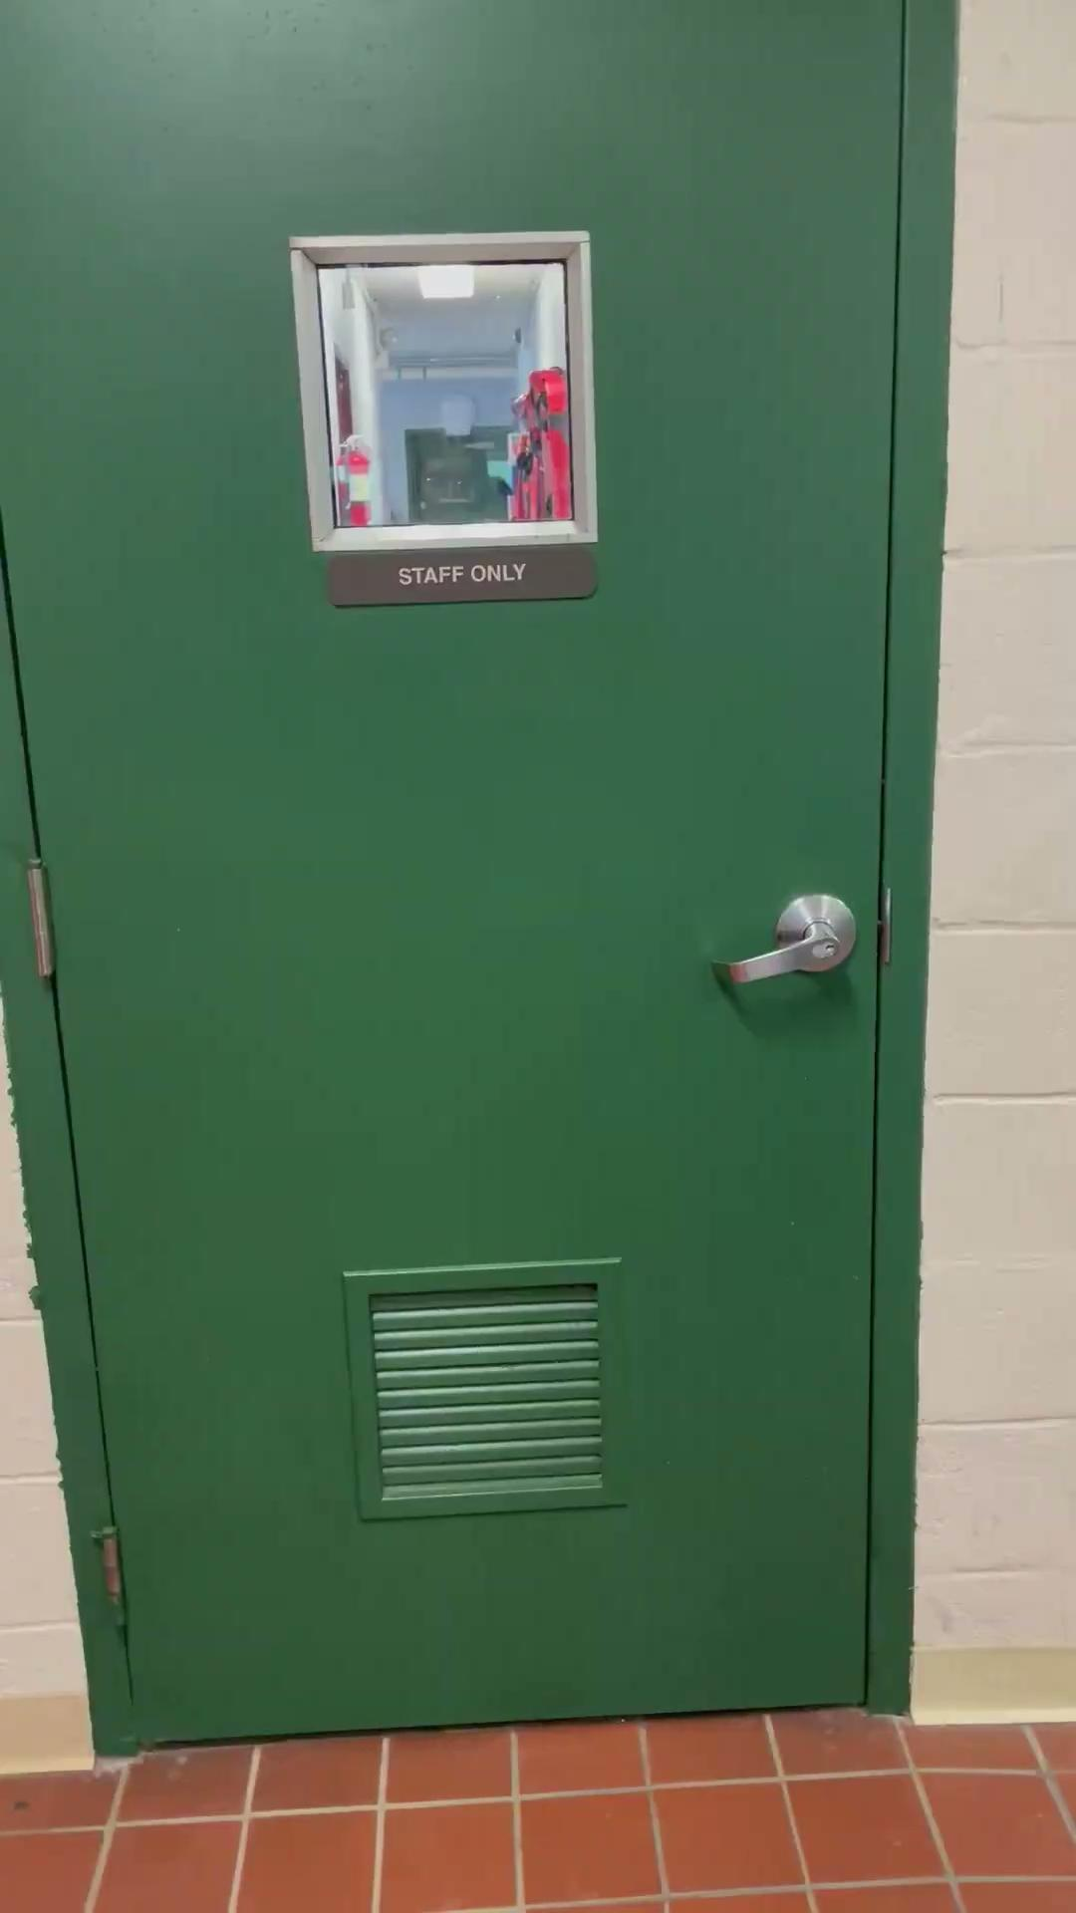
Showing Up Early for a Shift
It is important to arrive fifteen minutes early to a shift to ensure that you are prepared for the shift. Lifeguards will follow your lead.

Slide 8
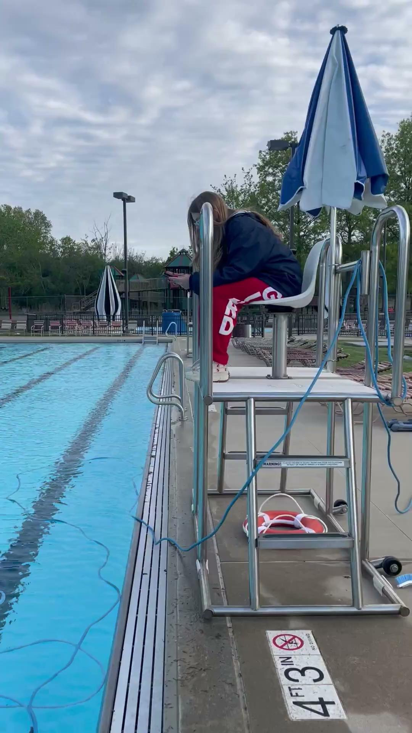
Distraction in the Stand
Oftentimes we see lifeguards talking to their friend or even using their phone or apple watch in the stand.

Slide 9
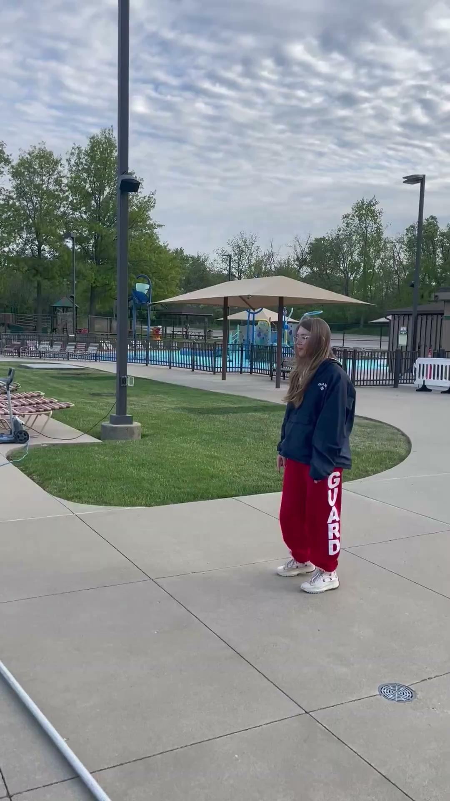
Redirecting Focus
When we see lifeguards distracted in the stand, it is important to determine the source distraction and redirect the lifeguard toward their duty to scan vigilantly when on duty.

Slide 10
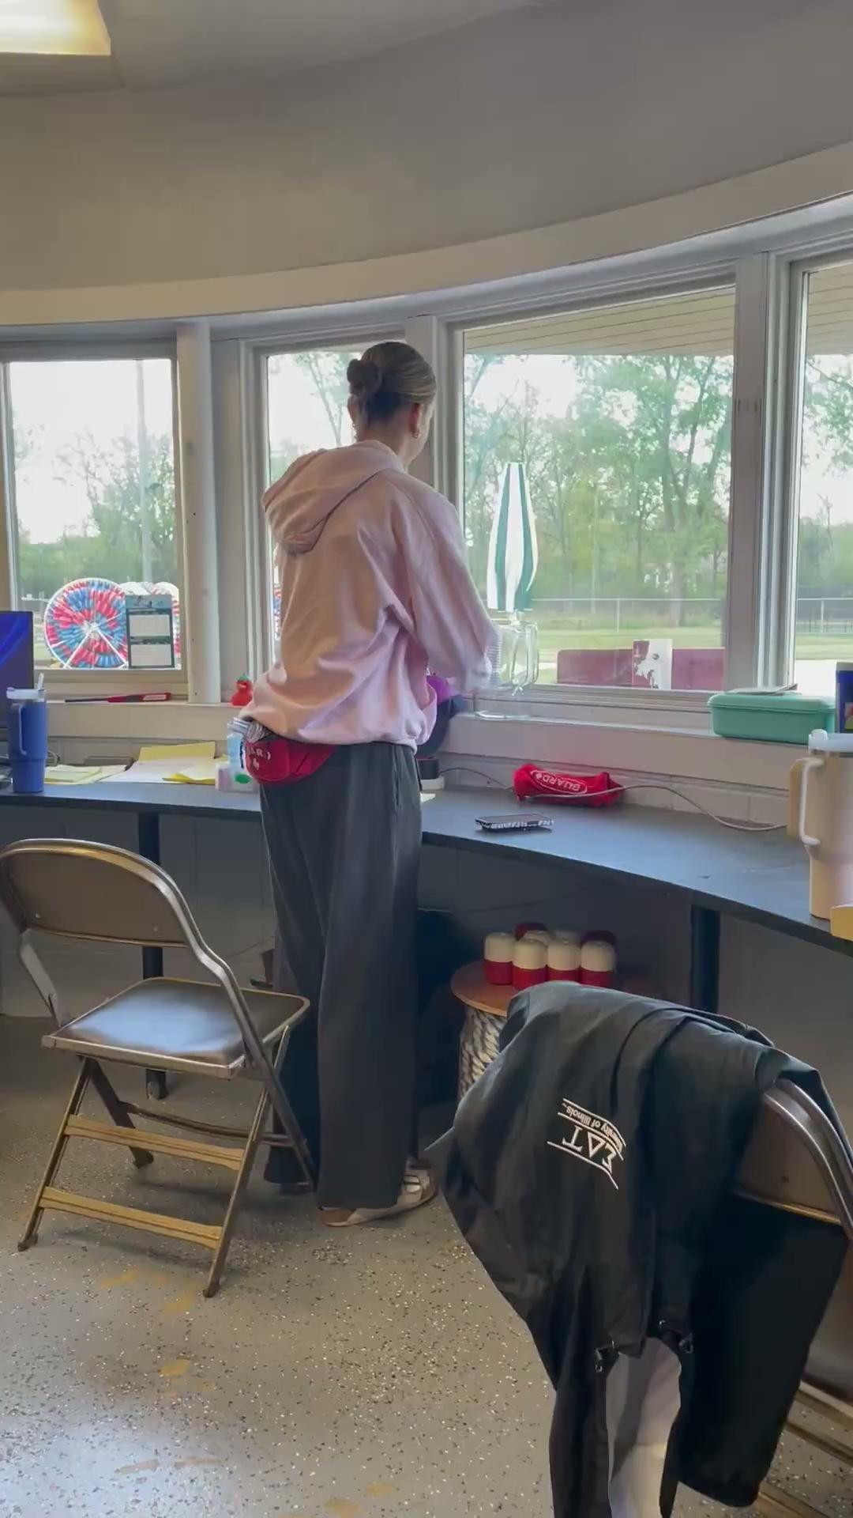
Disrespectful Communication
Sometimes we see employees who think that it is funny or appropriate to be sarcastic or passive aggressive in conversation with their coworkers. We may also see leadership talking down to lifeguards or being condescending.

Slide 11
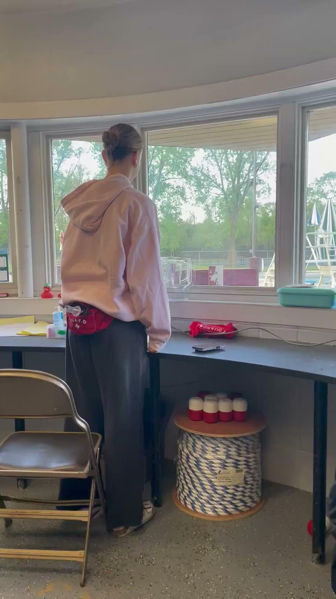
Respectful Communication
It is important to remember that we are all working toward the same purpose: to make the pool a safe and fun place for patrons. In order to do so we must treat our peers with respect through our tone, intent, and demeanor.

Slide 12
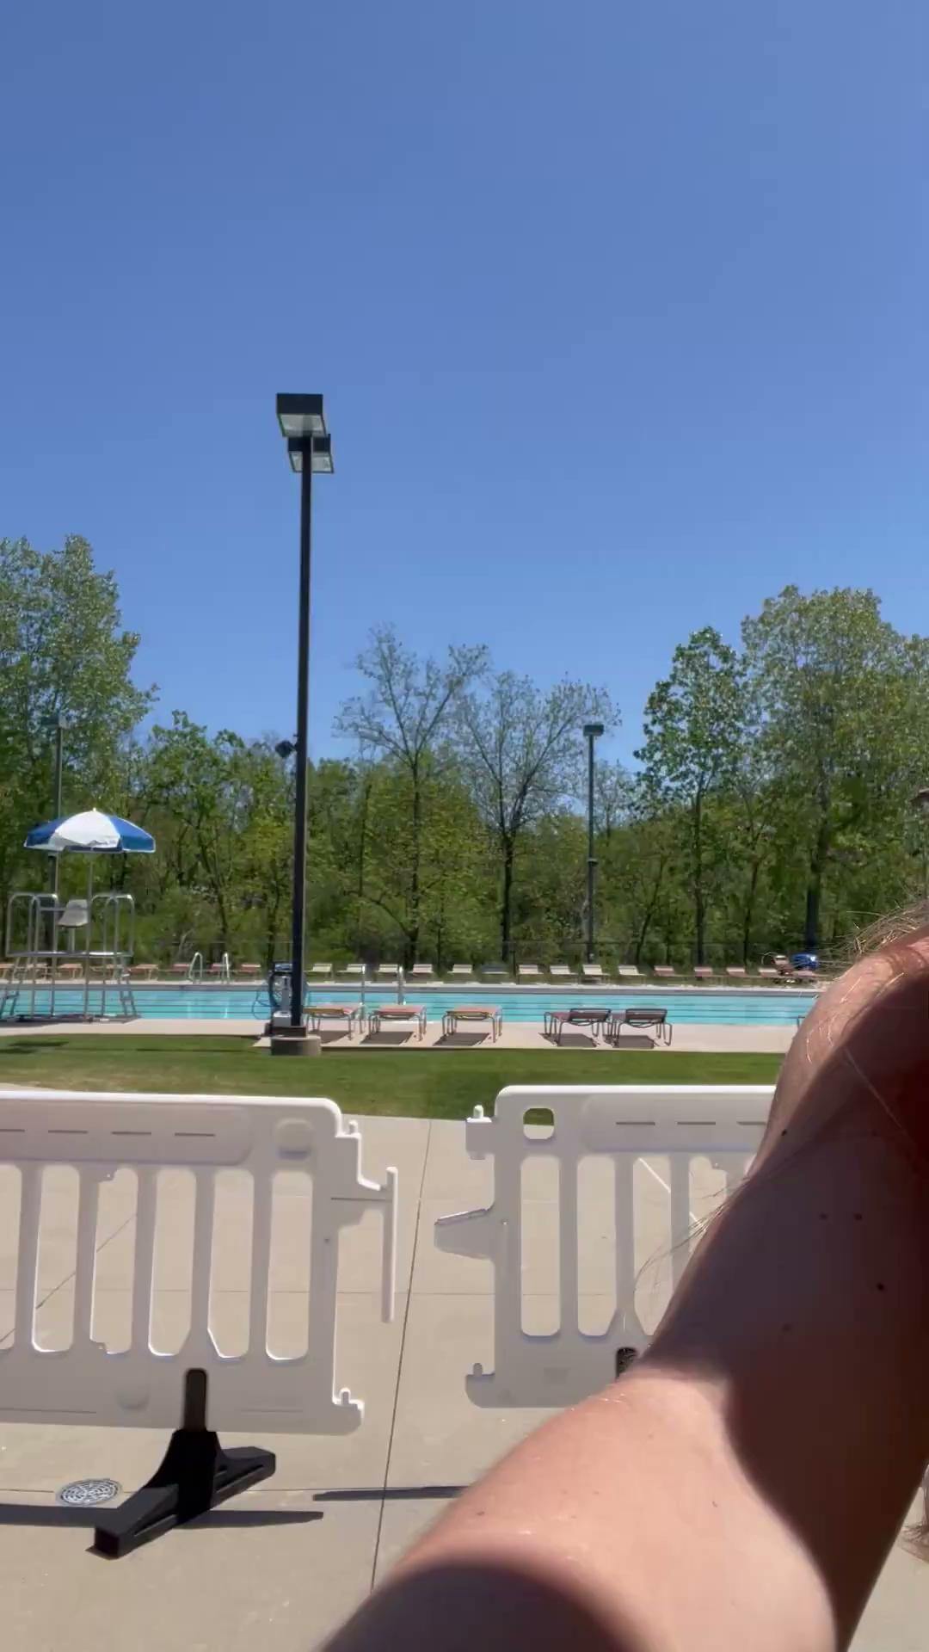
Brushing Off Mentorship
Sometimes we don’t have time for a mentorship or don’t want to mentor a specific person who asks us. Instead of telling them that we don’t have time or suggesting another mentor for them, we simply say no or leave them hanging.

Slide 13
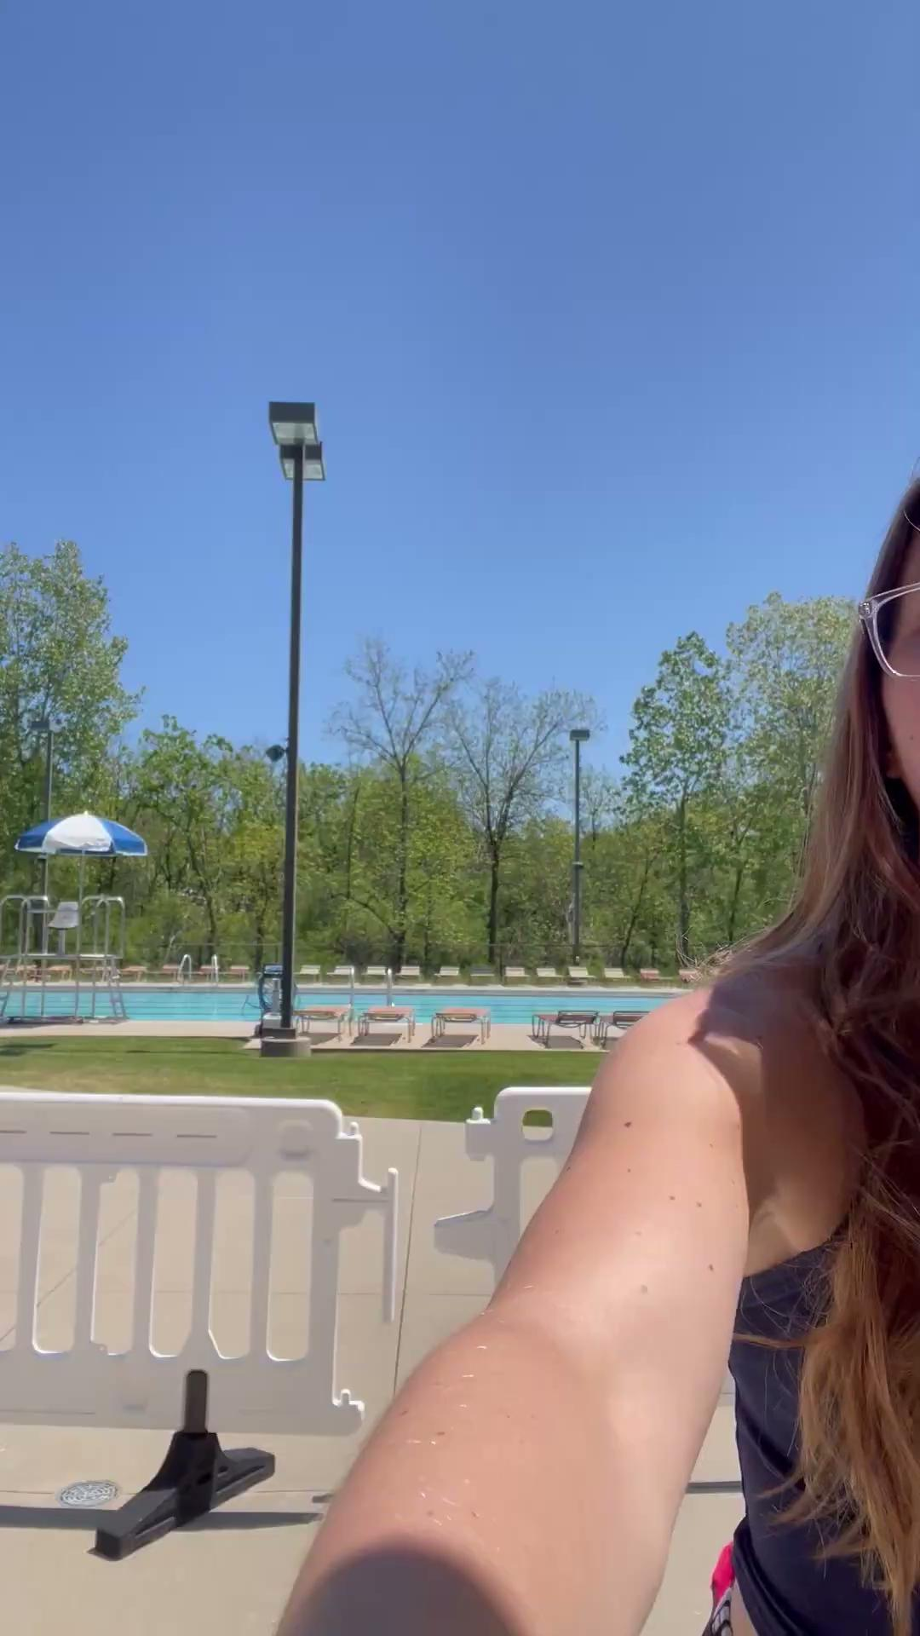
Mentorship
Mentorship is a large factor in promotion at the pools. If a lifeguard or head guard expresses interest in completing one to you, do not just brush it off. If you don't have the time or capacity to be their mentor, direct them to another member of leadership who would be a good fit for them, or explain that you could be their mentor later, just not now.

