Slide 1






HEADGUARD AND MANAGER
TRAINING

Slide 2


MODEL
“Treat others the way you want to be treated.”

Slide 3




LIFEGUARD INTERACTIONS
ALWAYS AWARE
ADVOCATE
REASON

Slide 4
INSERVICES
1
Plan
2
Use your resources
3
Don’t be afraid to be unsure

Slide 5
HEADGUARDS’ ROLE IN INSERVICES
Experts at the skills
Communicate with Managers
Plan

Slide 6


COMMUNICATION
PREPARED
CONFIDENT
CONCISE

Slide 7


GUARD OF THE MONTH
OPPORTUNITIES

Slide 8


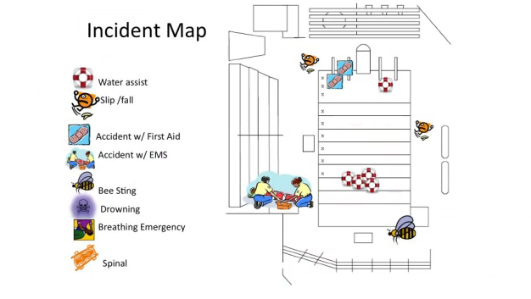


DOCUMENT EVERYTHING
Illinois Pool Codes

Slide 9

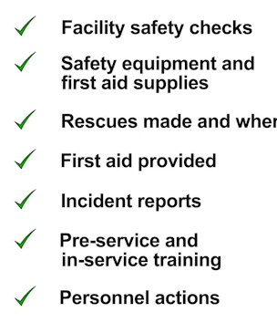

DOCUMENT EVERYTHING

Slide 10
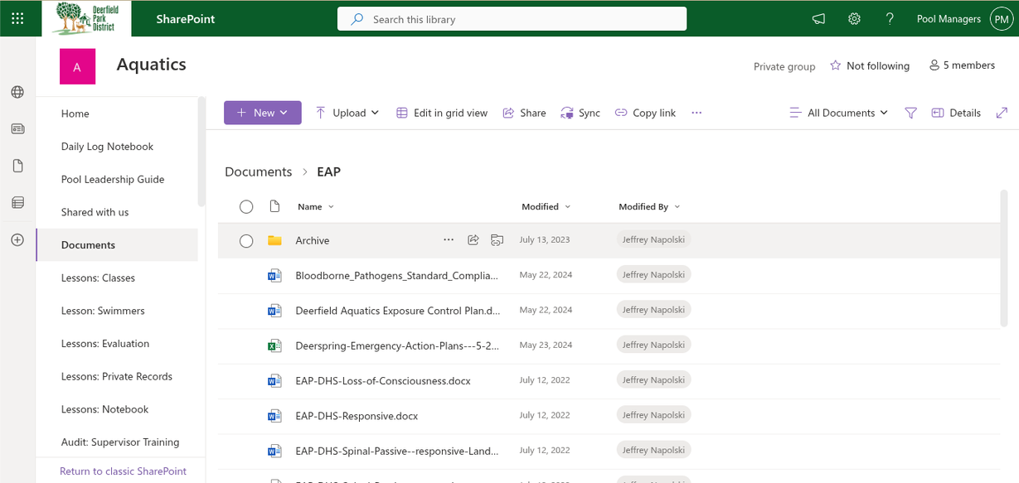

EAP
Illinois Pool Codes

Slide 11


Lifeguards never have the luxury of “having a bad day” and laziness is not acceptable

Slide 12
CRITICAL INCIDENT STRESS
Recognize the Symptoms
Debrief
Listen
Reassure
Prevent

Slide 13
PARTIES!
BE COURTEOUS

Slide 14



CUSTOMER SERVICE
INFORM
EDUCATE
ENFORCE

Slide 15
THANK
YOU

